Slide 1
Azure Cosmos db
A FULLY-MANAGED GLOBALLY DISTRIBUTED DATABASE SERVICE BUILT TO GUARANTEE
EXTREMELY LOW LATENCY AND MASSIVE SCALE FOR MODERN APPS

Slide 2
Powering global solutions
Azure Cosmos DB was built to support modern app patterns and use cases.
It enables industry-leading organizations to unlock the value of data and respond to global customers and changing business dynamics in real-time.
Data distributed and available globally
Build real-time customer experiences
Ideal for gaming, IoT & eCommerce
Simplified development with serverless architecture
Run Spark analytics over operational data
Lift and shift NoSQL data
Puts data where your users are
Enable latency-sensitive personalization, bidding, and fraud detection.
Predictable and fast service, even during traffic spikes
Fully-managed event-driven micro-services with elastic computing power
Accelerate insights from fast, global data
Lift and shift MongoDB and Cassandra workloads

Slide 3

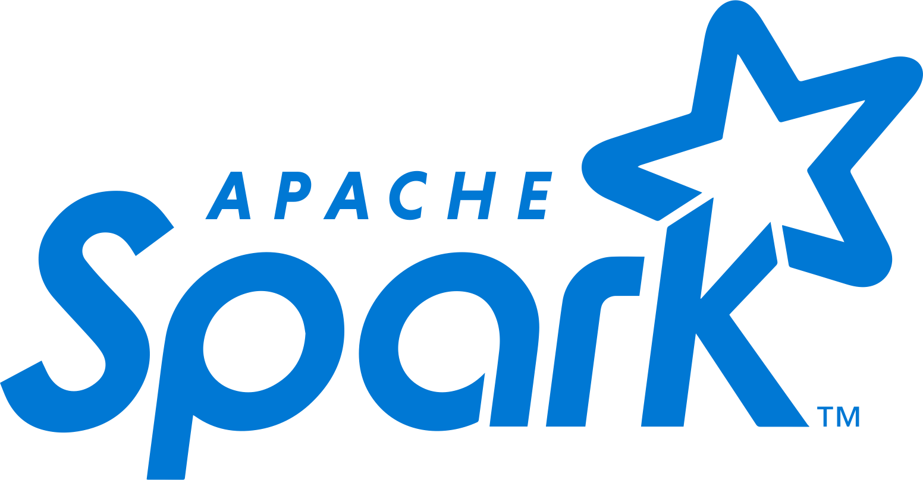



AZURE COSMOS DB
Core (SQL) API
Table API
MongoDB
Column-family
Document
Key-value
Graph
Guaranteed low latency at the 99th percentile
Elastic scale out
of storage & throughput
Five well-defined consistency models
Turnkey global distribution
Comprehensive SLAs

Slide 4
Turnkey global distribution
PUT YOUR DATA WHERE YOUR USERS ARE IN MINUTES
Automatically replicate all your data around the world, and across more regions than AWS and Google Cloud Platform combined.
Available in all Azure regions
Manual and automatic failover
Automatic & synchronous multi-region replication

Slide 5
ELASTIC SCALE OUT OF STORAGE AND THROUGHPUT
SCALES AS YOUR APPS’ NEEDS CHANGE
Independently and elastically scale storage and throughput across regions – even during unpredictable traffic bursts – with a database that adapts to your app’s needs.
Elastically scale throughput from 10 to 100s of millions of requests/sec across multiple regions
Support for requests/sec for different workloads
Pay only for the throughput and storage you need

Slide 6
FIVE WELL-DEFINED CONSISTENCY MODELS
CHOOSE THE BEST CONSISTENCY MODEL FOR YOUR APP
Offers five consistency models
Provides control over performance-consistency tradeoffs, backed by comprehensive SLAs.
An intuitive programming model offering low latency and high availability for your planet-scale app.
Strong
Bounded-stateless
Session
Consistent prefix
Eventual

Slide 7
Multiple data models and apis
USE THE MODEL THAT FITS YOUR REQUIREMENTS, AND THE APIS, TOOLS, AND FRAMEWORKS YOU PREFER
Choose from multiple APIs to access and query data, including SQL, MongoDB, Cassandra, Gremlin, Table, etcd, and Spark.
Use key-value, tabular, graph, and document data
Data is automatically indexed, with no schema or secondary indexes required.
Core (SQL) API
Table API
MongoDB
Column-family
Document
Key-value
Graph

Slide 8
Handle any data with no schema or indexing required
Azure Cosmos DB’s schema-less service automatically indexes all your data, regardless of the data model, to delivery blazing fast queries.
Automatic index management
Synchronous auto-indexing
No schemas or secondary indices needed
Works across every data model
GEEK
Item | Color | Microwave safe | Liquid capacity | CPU | Memory | Storage
Geek mug | Graphite | Yes | 16ox | ??? | ??? | ???
Coffee Bean mug | Tan | No | 12oz | ??? | ??? | ???
Surface book | Gray | ??? | ??? | 3.4 GHz Intel Skylake Core i7-6600U | 16GB | 1 TB SSD

Slide 9
Azure cosmos db
A globally distributed, massively scalable, multi-model database service.
MongoDB, Cassandra, Gremlin/graph, table, and NoSQL APIs
Elastic scale of storage and throughput
Multiple, well-defined consistency models
<10ms read and write latency guarantee
99.999% high-availability guarantee
Industry-leading SLAs across performance, latency, availability and throughput
Migrate NoSQL data and apps
Use multiple data and consistency models
Build real-time customer experiences
Ideal for IoT, gaming and eCommerce

Slide 10






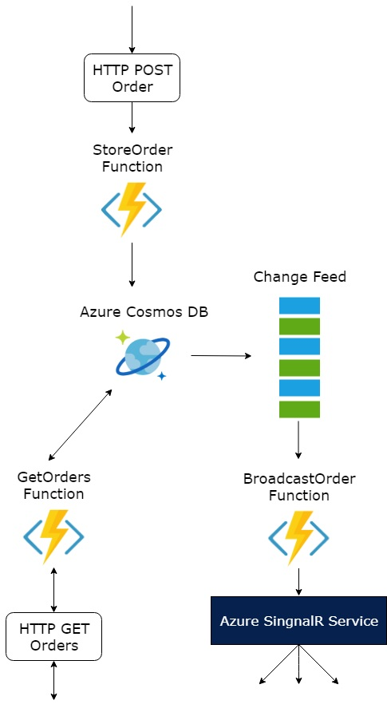

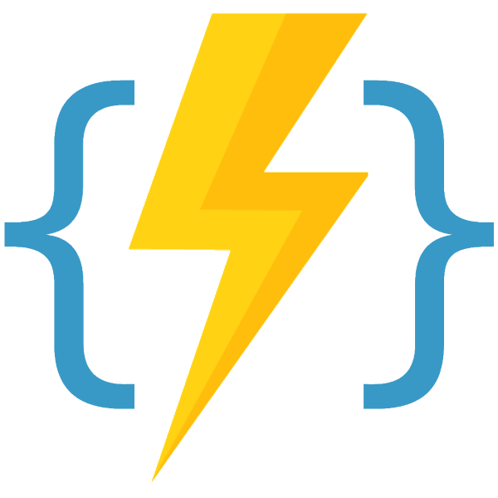

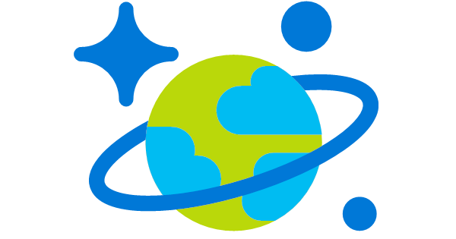

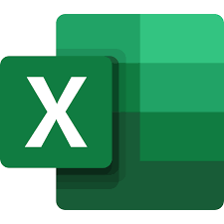


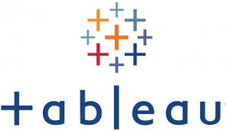

CONA Proposed BI Architecture - Overall
“Future use case”
INGEST
TRANSFORM & STORE
PREP & TRAIN
MODEL & SERVE
SparkR
Sensors and IoT
(unstructured)
“7 days retention / replay”
“Insights & Actions”
Real-time apps / Machine Learning Models
Azure Databricks
Other
Data Sources
“Tabular models with pre-calculated metrices”
Canned Reporting
Azure Event Hub
Azure Analysis Services
Logs (unstructured)
Stream Analytics
Change Feed
Functions
Media (unstructured)
Cosmos DB
Azure Databricks
Optional
SparkSQL
Files (unstructured)
“7 days+ (longer term) retention”
“ODBC / JDBC Drivers”
Optional
Attunity or similar
ETL Tool w/ CDC
Ad-Hoc Reporting
Business/custom apps
(structured)
ADLS

Slide 11
Spark Introduction

Slide 12

The Big Data Problem
Data growing faster than computation speeds
Growing data sources
» Web, mobile, scientific
Storage getting cheaper
Size doubling every 18 months
CPU speeds and storage bottlenecks

Slide 13
The Big Data Problem
A single machine can no longer process or even store all the data!
Only solution is to distribute data over large clusters
Datacenter

Slide 14
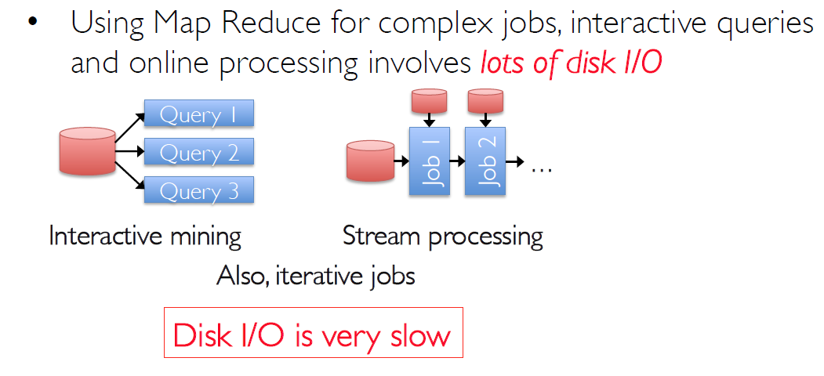
Apache Spark Motivation

Slide 15
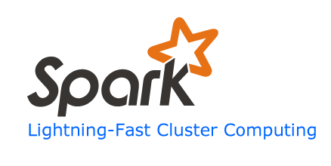
Spark
Keep more data in-memory
Create new distributed execution engine:

Slide 16
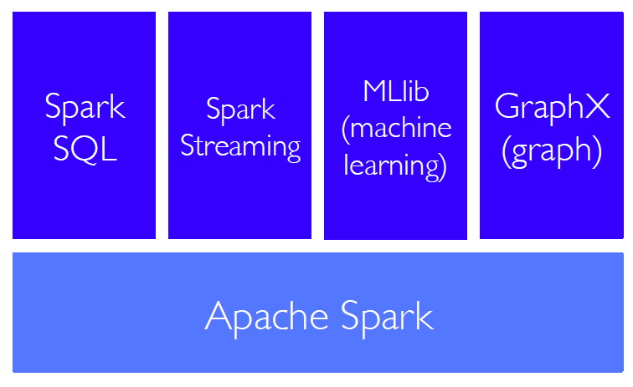
Spark Tools

Slide 17
Spark Tools
Spark SQL is Spark's module for working with structured data.
Use the Spark shell to write interactive SQL queries
Spark Streaming makes it easy to build scalable fault-tolerant streaming applications.
Process a sample of Twitter tweet streams
MLlib is Apache Spark's scalable machine learning library.
Build a movie recommender with Spark
GraphX is Apache Spark's API for graphs and graph-parallel computation.
Explore graph-structured data and graph algorithms
Notes:
Graph PageRank

Slide 18
Spark - MLlib
Basic statistics
summary statistics
correlations
hypothesis testing
Classification and regression
linear models (SVMs, logistic regression, linear regression)
naive Bayes
Collaborative filtering
alternating least squares (ALS)
Clustering
k-means
Dimensionality reduction
singular value decomposition (SVD)
Frequent pattern mining
FP-growth
association rules
Optimization (developer)
stochastic gradient descent
Notes:
http://spark.apache.org/docs/latest/mllib-guide.html

Slide 19
Resilient Distributed Datasets (RDDs)
Write programs in terms of operations on distributed datasets
Partitioned collections of objects spread across a cluster, stored in memory or on disk
RDDs built and manipulated through a diverse set of parallel transformations (map, filter, join) and actions (count, collect, save)
RDDs automatically rebuilt on machine failure

Slide 20



Azure Databricks A fast, easy and collaborative Apache® Spark™ based analytics platform optimized for Azure
Best of Databricks
Best of Microsoft
Designed in collaboration with the founders of Apache Spark
One-click set up; streamlined workflows
Interactive workspace that enables collaboration between data scientists, data engineers, and business analysts.
Native integration with Azure services (Power BI, SQL DW, Cosmos DB, Blob Storage)
Enterprise-grade Azure security (Active Directory integration, compliance, enterprise-grade SLAs)
Notes:
Azure Databricks is an Apache Spark-based analytics platform optimized for the Microsoft Azure cloud services platform. Designed with the founders of Apache Spark, Databricks is integrated with Azure to provide one-click setup, streamlined workflows, and an interactive workspace that enables collaboration between data scientists, data engineers, and business analysts.
Enhance your teams’ productivity
Get started quickly by launching your new Spark environment with one click.
Improve collaboration amongst your analytics team through a unified workspace.
Innovate faster with native integration with rest of Azure platform.
Integration with Azure services
Azure Databricks integrates deeply with Azure databases and stores: SQL Data Warehouse, Cosmos DB, Data Lake Store, and Blob Storage.
Through rich integration with Power BI, Azure Databricks allows you to discover and share your impactful insights quickly and easily. You can use other BI tools as well, such as Tableau Software via JDBC/ODBC cluster endpoints.
Build on the most compliant and trusted cloud
Simplify security and identity control with built-in integration with Active Directory.
Regulate access with fine-grained user permissions to Azure Databricks’ notebooks, clusters, jobs and data.
Build with confidence on the trusted cloud backed by unmatched support, compliance and SLAs.
Scale without limits
Operate at massive scale without limits globally.
Accelerate data processing with the fastest Spark engine.

Slide 21

Azure Databricks
Azure Databricks
Collaborative Workspace
IoT / streaming data
Machine learning models
DATA ENGINEER
DATA SCIENTIST
BUSINESS ANALYST
Deploy Production Jobs & Workflows
Cloud storage
BI tools
MULTI-STAGE PIPELINES
JOB SCHEDULER
NOTIFICATION & LOGS
Data warehouses
Optimized Databricks Runtime Engine
Data exports
Hadoop storage
DATABRICKS I/O
APACHE SPARK
SERVERLESS
Rest APIs
Data warehouses
Enhance Productivity
Build on secure & trusted cloud
Scale without limits
Notes:
Apache Spark in Azure Databricks
Azure Databricks builds on the capabilities of Spark by providing a zero-management cloud platform that includes:
Fully managed Spark clusters
An interactive workspace for exploration and visualization
A platform for powering your favorite Spark-based applications
Fully managed Apache Spark clusters in the cloud
Azure Databricks has a secure and reliable production environment in the cloud, managed and supported by Spark experts. You can:
Create clusters in seconds.
Dynamically autoscale clusters up and down, including serverless clusters, and share them across teams.
Use clusters programmatically by using the REST APIs.
Use secure data integration capabilities built on top of Spark that enable you to unify your data without centralization.
Get instant access to the latest Apache Spark features with each release.
Databricks Runtime
The Databricks Runtime is built on top of Apache Spark and is natively built for the Azure cloud.
With the Serverless option, Azure Databricks completely abstracts out the infrastructure complexity and the need for specialized expertise to set up and configure your data infrastructure. The Serverless option helps data scientists iterate quickly as a team.
For data engineers, who care about the performance of production jobs, Azure Databricks provides a Spark engine that is faster and performant through various optimizations at the I/O layer and processing layer (Databricks I/O).
Workspace for collaboration
Through a collaborative and integrated environment, Azure Databricks streamlines the process of exploring data, prototyping, and running data-driven applications in Spark.
Determine how to use data with easy data exploration.
Document your progress in notebooks in R, Python, Scala, or SQL.
Visualize data in a few clicks, and use familiar tools like Matplotlib, ggplot, or d3.
Use interactive dashboards to create dynamic reports.
Use Spark and interact with the data simultaneously.
Enterprise security
Azure Databricks provides enterprise-grade Azure security, including Azure Active Directory integration, role-based controls, and SLAs that protect your data and your business.
Integration with Azure Active Directory enables you to run complete Azure-based solutions using Azure Databricks.
Azure Databricks roles-based access enables fine-grained user permissions for notebooks, clusters, jobs, and data.
Enterprise-grade SLAs.

Slide 22
Azure Databricks
Azure Machine Learning
Enable collaboration between data scientists and data engineers with an interactive productive workspace
Prepare and clean data at massive scale with the language of your choice
Build and train models with pre-configured machine learning and deep learning optimized clusters
Track experiments for reproducibility
and auditing needs. Identify and promote your best models
Deploy and manage your models using containers to run them anywhere
Notes:
Azure Databricks is the ideal environment for developing your models and testing these models
Spark can be used to deploy as well however in many cases this is not the ideal environment for deployment and scoring
(NOT YET RELEASED) Azure Machine Learning can take the output from Azure Databricks and via A Python SDK and Command Line Interface to deploy the model using Azure Kubernetes Service (AKS) using Docker.

Slide 23
Azure Databricks
A fast, easy, and collaborative Azure service for Apache Spark-based analytics
Productive
Secure
Scalable
Set up Spark clusters in minutes with one click from the Azure portal
Use the language of your choice with Python, R, Scala, SQL
Improve collaboration through a unified workspace and collaborate live with notebooks
Simplify security and identity control with built-in integration with Azure Active Directory and role-based access
Regulate access with fine-grained user permissions to Azure Databricks’ notebooks, clusters, jobs and data
Build with confidence on the trusted cloud backed by unmatched support, and compliance
Autoscale effortlessly
Integrate seamlessly with other Azure data services
Benefit from enterprise-grade SLAs
Operate at massive scale, without limits, globally
Seamlessly integrated with the Azure portfolio
Notes:
Azure Databricks is a fast, easy and collaborative Apache® Spark™ based analytics platform optimized for Azure. Designed in collaboration with the founders of Apache Spark, Azure Databricks combines the best of Databricks and Azure to help customers accelerate innovation with one-click set up; streamlined workflows and an interactive workspace that enables collaboration between data scientists, data engineers, and business analysts. Customers automatically benefit native integration with other Azure services such as Power BI, SQL Data Warehouse, Cosmos DB as well as from enterprise-grade Azure security, including Active Directory integration, compliance, and enterprise-grade SLAs.
Augment your existing data systems by training and evaluating ML models in Azure Databricks.
With Azure Databricks, you can:
Enhance your teams’ productivity
Get started quickly by launching your new Spark environment with one click
Improve collaboration amongst your analytics team through a unified workspace
Build on the most compliant and trusted cloud
Build with confidence, backed by unmatched support, compliance and SLAs.
Regulate access with fine-grained user permissions to Azure Databricks’ notebooks, clusters, jobs and data.
Scale without limits
Operate at massive scale without limits globally.
Open-source data processing engine built around speed, ease of use, and sophisticated analytics
In memory engine that is up to 100 times faster than Hadoop
Largest open-source data project with 1000+ contributors
Highly extensible with support for Scala, Java and Python alongside Spark SQL, GraphX, Streaming and Machine Learning Library (Mllib)

Slide 24
Thank You

